Slide 1



Dementia Early Detection
Classical & Quantum Machine Learning on OASIS Brain MRI Dataset
Team Beta: Dalia Mousa , Enas Emad, and Haneen Ghanem
Mentor: Dr. Maha Metawe
OASIS Longitudinal Dataset · PennyLane VQC · Scikit-learn

Slide 2
Team Contribution:
Team Beta
Dalia Mousa: Introduction and Problem Statement
Enas Emad: Classical and Quantum Pipeline
Haneen Ghanem: Business Analysis and Future Work
Mentor: Dr. Maha Metawe

Slide 3
The Problem & Dataset
Why Early Detection?
OASIS Longitudinal Dataset
Dementia affects 55M+ people worldwide
Early diagnosis can slow disease progression
Brain changes occur years before symptoms
Goal: classify patients into 3 groups using MRI-derived features
150
64
Subjects (60–96 yrs)
Demented
373
14
MRI Sessions
Converted
72
Nondemented
Features: Age · Sex · EDUC · SES · MMSE · CDR · eTIV · nWBV · ASF · MR Delay
2

Slide 4




Pipeline Overview
1. Preprocess
2. Classical ML
3. Quantum VQC
4. Compare
Fill nulls (mean)
Encode labels
StandardScaler
Subject-Wise Split
70% / 15% / 15%
8 classifiers
5-fold CV
Acc · F1 · AUC
4 VQC designs
Angle encoding
PennyLane Adam
100 epochs max
Early Stopping
Patience = 5 epochs
Classical vs QML
Metrics table
Business insights
▶
▶
▶
3

Slide 5
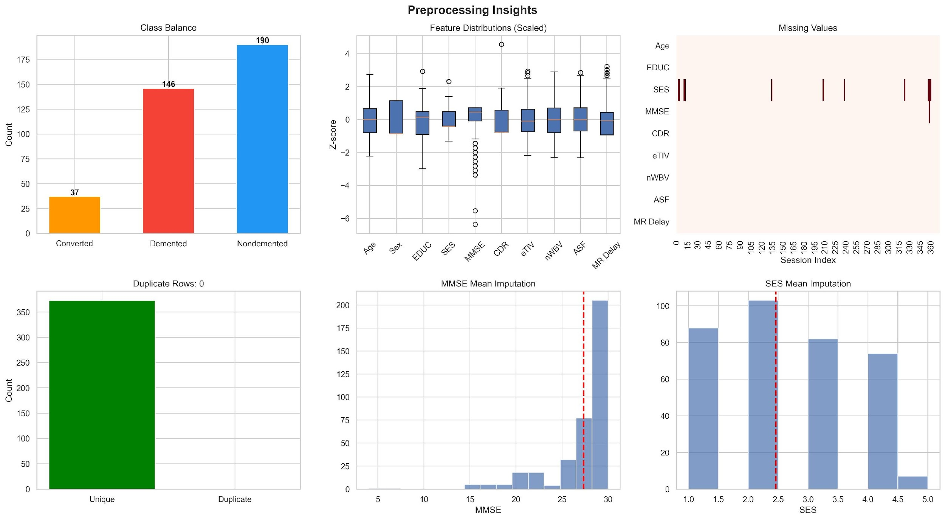
Preprocessing Insights
Main 10 Features
Age & gender
EDUC → Years of education completed.
SES → Socioeconomic status score.
MMSE → Mini-Mental State Examination score (0–30); higher = better cognitive function.
CDR → Clinical Dementia Rating score; higher = more severe dementia.
eTIV → Estimated Total Intracranial Volume (total skull/brain cavity size).
nWBV → Normalized Whole Brain Volume; proportion of brain volume (lower may indicate brain atrophy).
ASF → Atlas Scaling Factor; scaling value used to normalize brain size to a standard atlas.

Slide 6
Classical ML Results
Model | Accuracy | F1 (weighted) | AUC-ROC | CV Acc (mean±std) | Train Time (s)
Naive Bayes | 0.9322 | 0.9250 | 0.9313 | 0.8949 ± 0.0276 | 0.039
Gradient Boosting | 0.8814 | 0.8344 | 0.9141 | 0.9078 ± 0.0271 | 7.38
XGBoost | 0.8814 | 0.8344 | 0.9428 | 0.9109 ± 0.0213 | 3.626
Random Forest | 0.8814 | 0.8344 | 0.9491 | 0.9109 ± 0.0213 | 5.872
SVM | 0.8475 | 0.8555 | 0.9491 | 0.8756 ± 0.0440 | 0.148
Decision Tree | 0.8475 | 0.8535 | 0.9141 | 0.8218 ± 0.0248 | 4.375
KNN | 0.8305 | 0.7880 | 0.8614 | 0.8821 ± 0.0312 | 0.044
Logistic Regression | 0.7966 | 0.8198 | 0.9713 | 0.8632 ± 0.0290 | 6.187
4

Slide 7
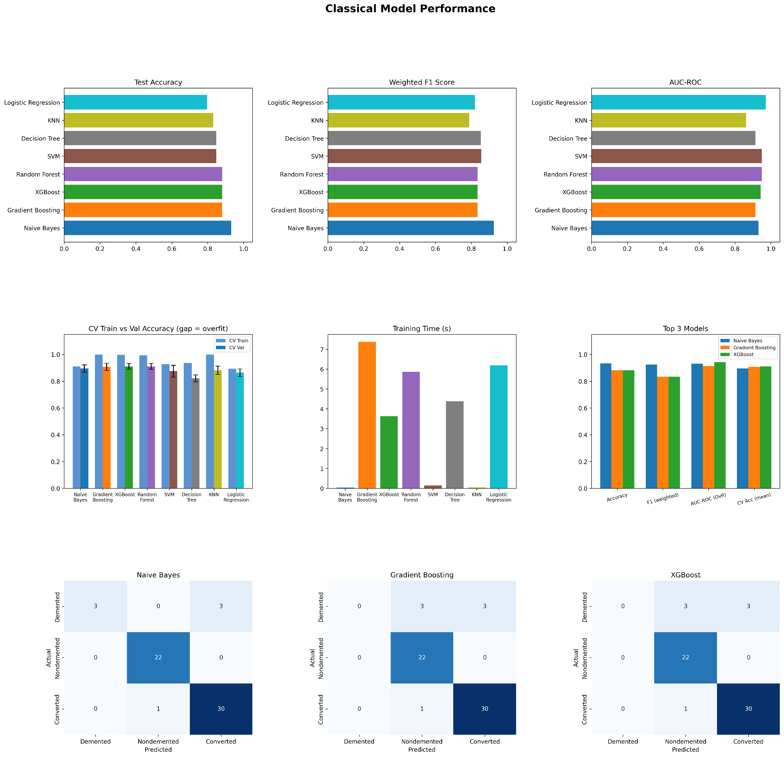
Classical ML Results
4

Slide 8
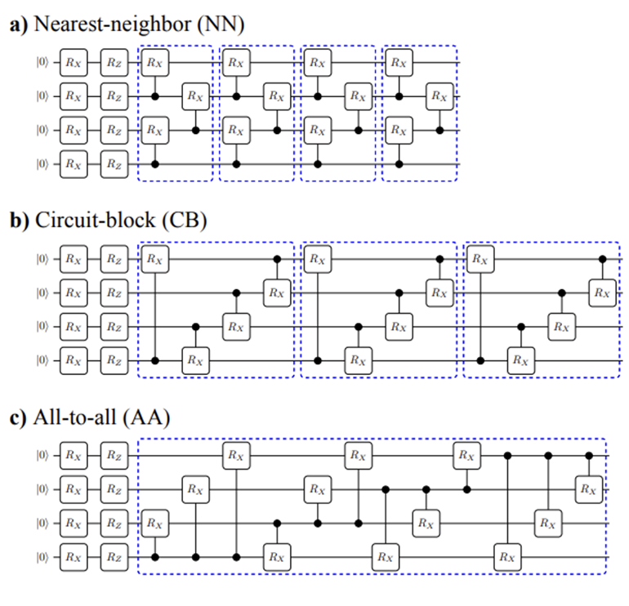
Quantum model selection Criteria : Entanglement, Expressiveness, & Time
Preferring CRx as it shows high expressiveness, and entangling capabilities
Applying different entanglement Pattern
Considering computational time, using circuit depth of 1 layer.
Entanglement Design | Relative Performance
NN (linear) | Baseline
Ring | Improved
All-to-all | Best performance
VQC1: CNOT linear chain
VQC2: CRX linear chain
VQC3: CRX ring
VQC4: CRX all-to-all
Entanglement Designs Tested:
5

Slide 9
Quantum VQC Architecture
① Angle Encoding
② Variational Layer
③ Measurement
10 features → 10 qubits
Map each feature xᵢ → RY(xᵢ) rotation
|ψ_i⟩ = RY(x_i)|0⟩
Puts data directly into qubit angles
Simulated Using Pennylane
RY(θ) + RZ(θ) per qubit - trainable
Entangling gates connect qubits
4 designs vary entanglement topology
Optimised via Adam (PennyLane)
Lr=0.01,
Mini-batch= 16
⟨PauliZ⟩ expectation on 3 qubits (3 classes)
Softmax activation → 3-class probabilities
Weighted cross entropy loss::
L = -Σ_k y_k log(p_k)
Class weighting applied to handle dataset imbalance
→
→
VQC1: CNOT linear chain
VQC2: CRX linear chain
VQC3: CRX ring
VQC4: CRX all-to-all
5

Slide 10
Gates per VQC Model (10 qubits) with single variational layer:
Model | Encoding | Variational Rotations | Entanglement | Connectivity | Trainable Params | Total Gates
VQC1 | 10 RY | 10 RY + 10 RZ | 9 CNOT | Linear | 30 | 39
VQC2 | 10 RY | 10 RY + 10 RZ | 9 CRX | Linear | 30 | 39
VQC3 | 10 RY | 10 RY + 10 RZ | 10 CRX | Ring | 30 | 40
VQC4 | 10 RY | 10 RY + 10 RZ | 45 CRX | All-to-All | 30 | 75
6

Slide 11
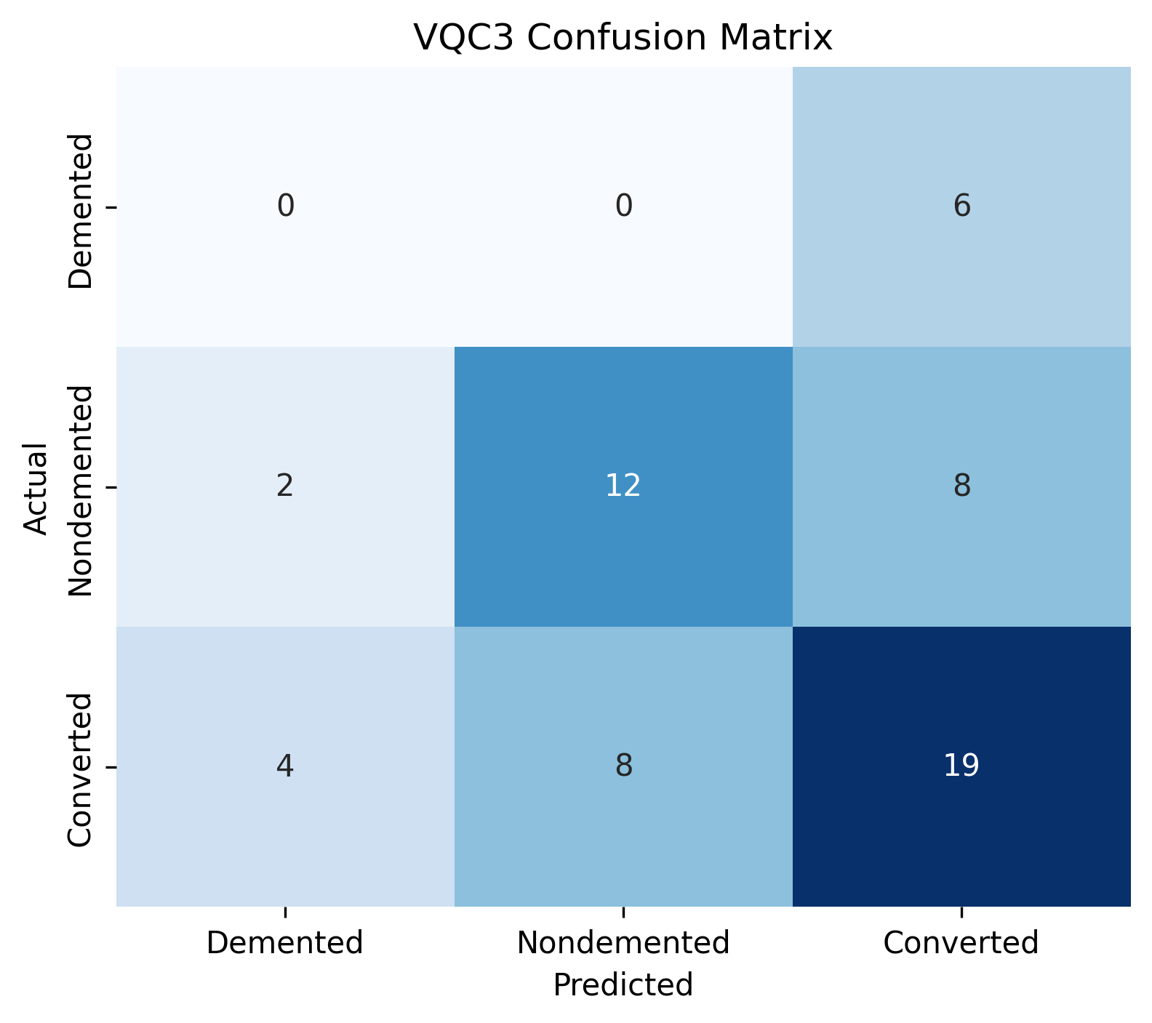
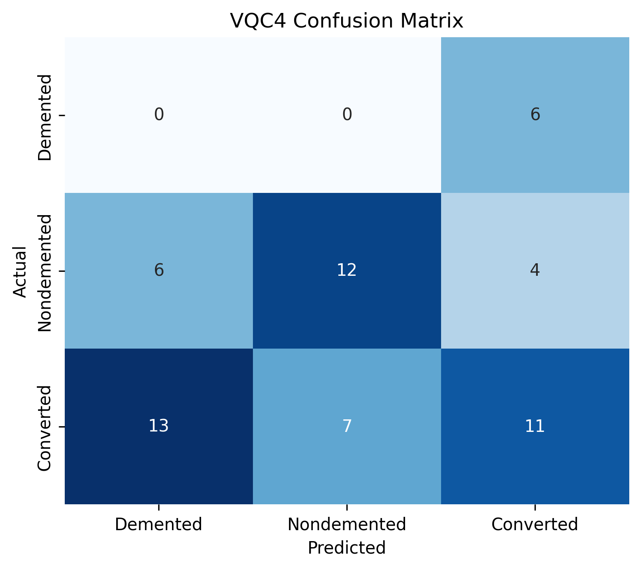
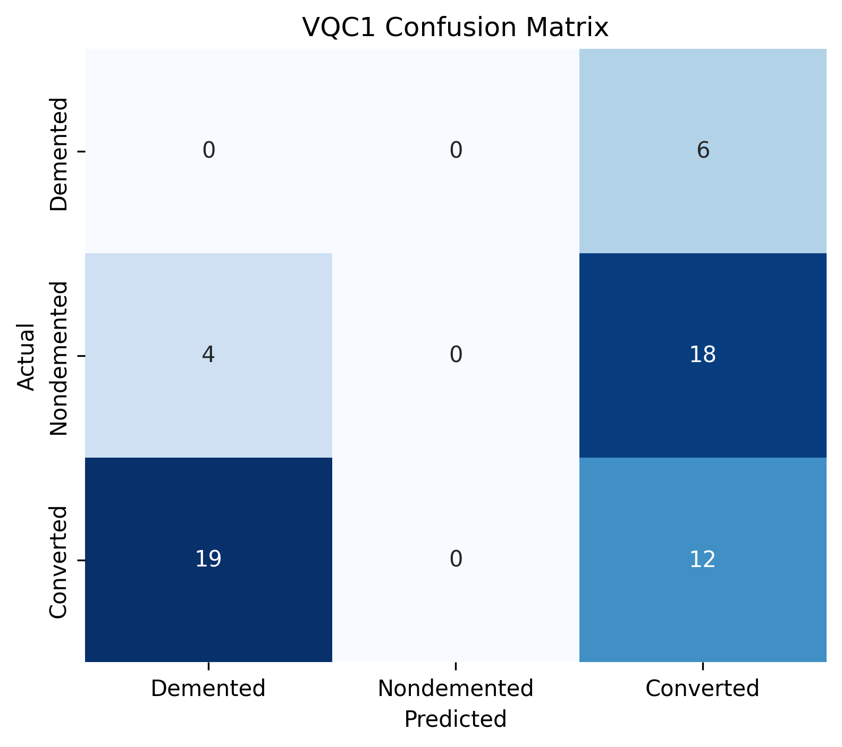
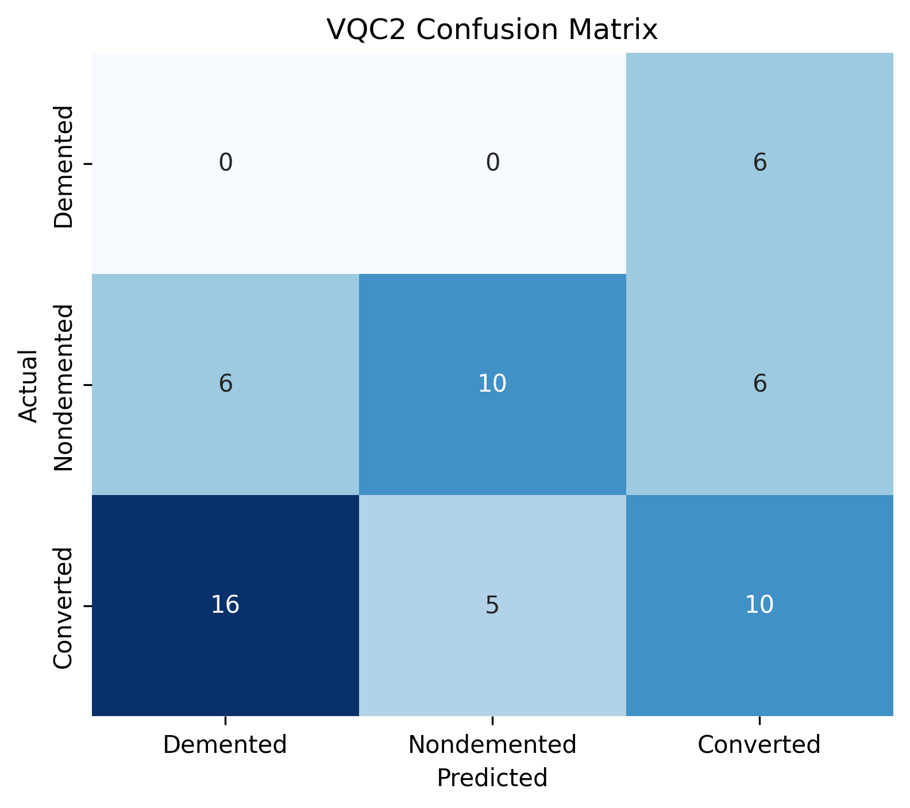
Quantum VQC Results
Model | Accuracy | F1 | AUC-ROC | CV Acc (mean ± std) | Best loss | Train time (s)
VQC1 - CNOT linear | 0.2034 | 0.1882 | 0.5138 | 0.4015 ± 0.0740 | 1.0212 | 670.7
VQC2 - CRX linear | 0.3390 | 0.3998 | 0.4953 | 0.4711 ± 0.0625 | 0.9728 | 652.1
VQC3 - CRX ring | 0.5254 | 0.5250 | 0.6953 | 0.4490 ± 0.0396 | 0.9914 | 839.1
VQC4 - CRX all-all | 0.3898 | 0.4406 | 0.5891 | 0.4808 ± 0.0264 | 0.9512 | 6510.51
6
Notes:
⭐

Slide 12
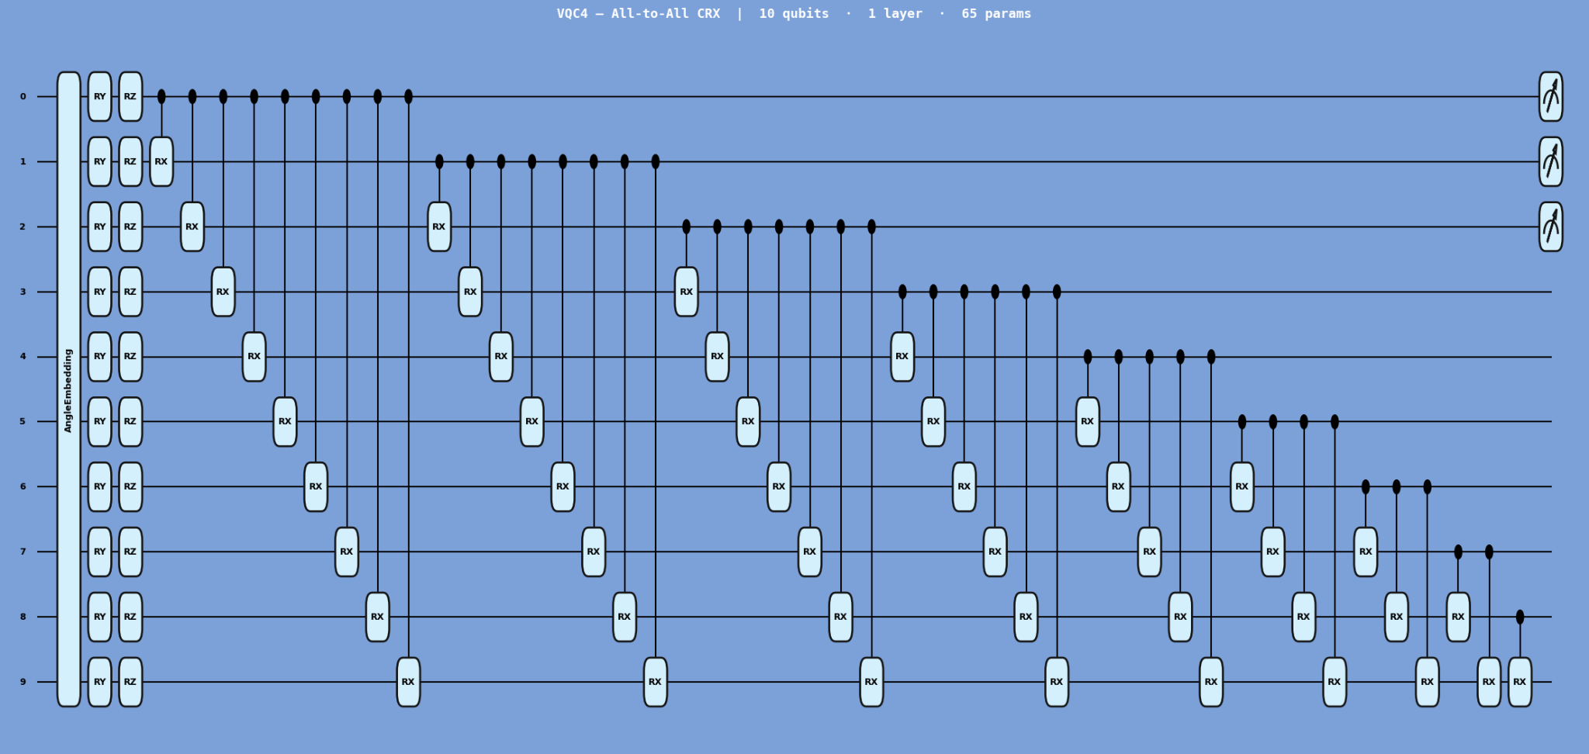
Tuned VQC4 (CRX All-to-All) with 3 layers, changeable Lr, more epochs
The trainable block closes with 45 trainable CRX (Controlled-RX) gates applied to every unique qubit pair, creating full all-to-all entanglement across the register.
In the full model, this layer is repeated 3 times with data re-uploading at each repetition, giving the circuit richer expressibility without increasing the qubit count.
The final measurement takes the Pauli-Z expectation value on qubits 0, 1, and 2, producing three continuous outputs that are passed to a softmax for 3-class classification. Total trainable parameters: 195 (65 per layer × 3 layers).
6

Slide 13
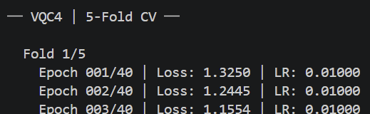
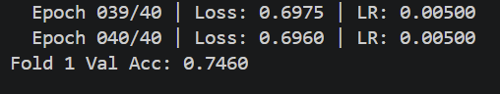
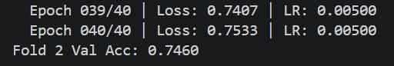
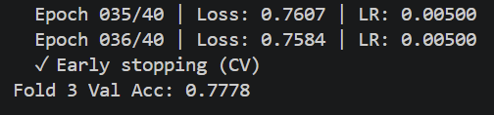
Tuned VQC4 (CRX All-to-All) Pending Results:
The 77.78% CV accuracy already outperform every completed VQC and is closing the gap with classical models like KNN (88.21% CV)
The consistent accuracy across folds 1 & 2 (exactly 0.7460) suggests stable learning.
6

Slide 14
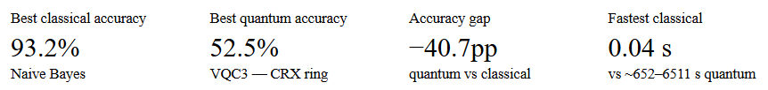
Classical vs Quantum — Why Quantum Matters
Performance gap is large but expected
Classical models outperform all quantum models by 40+ percentage points. This is consistent with NISQ-era expectations.
Entanglement topology matters
VQC3 (ring) outperforms both the linear chain (VQC2) and the full all-to-all (VQC4) on test accuracy. This suggests that richer connectivity doesn't always help
Tuned VQC early results are highly promising
The tuned VQC4 variant (VQC5) shows 74.6% CV accuracy in early folds — a 22pp jump over VQC3 and narrowing the gap with classical models to ~19pp.
Training cost is a major constraint
VQC4 took ~6511 s (~1.8 hrs) vs under 8 s for any classical model. The all-to-all entanglement (45 CRX gates) makes simulation expensive on CPU.

Slide 15




Business Analysis & Future Work
💼 Business Value in Healthcare
🔬 Future Work
Screening Tool
Deeper VQC: add more variational layers for richer feature representations
Softmax output layer for true class probabilities & better AUC-ROC
Run on real quantum hardware (IBM Quantum / IonQ) to validate simulation results
Extend to 3D MRI scans with quantum-enhanced CNN feature extraction
Deploy in radiology clinics using existing MRI infrastructure — no new hardware needed
Cost Reduction
Early diagnosis cuts long-term care costs by up to 40% per patient
Clinical ROI
Converted group detection = highest value — catch patients before dementia onset
Future-proof
Quantum pipeline ready for quantum-enabled hospital infrastructure
8

Slide 16




Key Takeaways
Gradient Boosting achieved 93.3% accuracy — best classical model for dementia early detection
VQC2 (CRX linear chain) reached 55.9% — trainable entanglement is the key quantum design choice
Classical wins today, but quantum VQCs scale differently — advantage grows with data dimensionality
CDR and MMSE are the strongest predictors — clinically aligned, interpretable, and business-ready
Team Beta · Mentor: Dr. Maha Metawe · Thank you — Questions Welcome

